Slide 1
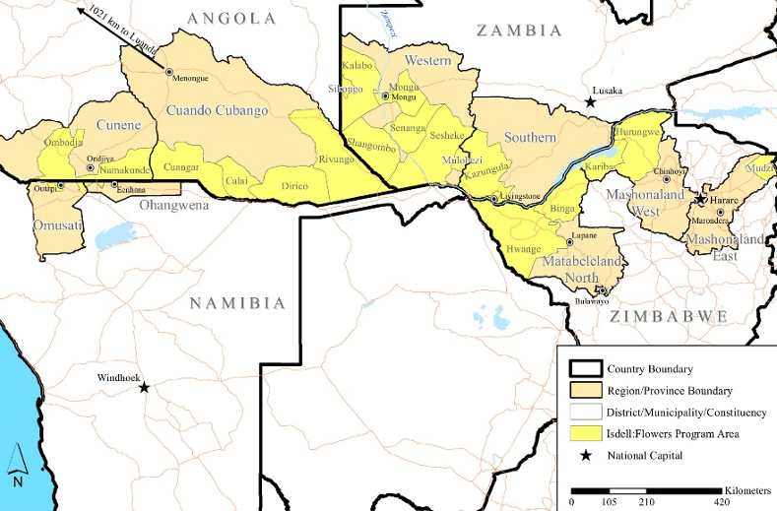
Understanding malaria knowledge, preventive practices, and care-seeking behavior among communities in border areas of Angola, Namibia, and Zambia, and identifying opportunities for improvement
Alysse Maglior^{1,2}, Alexandra Gordon^{1,2}, Rebecca J. Vander Meulen^{1,2}, Jesse Heitner³, Constance Njovu^{2,4}, João Lino Rafael^{2,5}, Stefanus Nangombe^{2,6}, José Franco Martins⁷, Petrina Uusiku⁸, Busiku Hamainza⁹
PRESENTATION 736 | POSTER SESSION B
¹J.C. Flowers Foundation New York, NY, United States, ²Isdell:Flowers Cross Border Malaria Initiative, ³University of Washington, Seattle, WA, United States, ⁴Anglican Diocese of Lusaka, Lusaka, Zambia, ⁵Anglican Diocese of Angola, Luanda, Angola, ⁶Namibia Anglican Community Development Organization, Windhoek, Namibia, ⁷National Malaria Control Program, Ministry of Health, Luanda, Angola, ⁸National Vector-borne Disease Control Programme, Ministry of Health and Social Services, Windhoek, Namibia, ⁹National Malaria Elimination Centre, Ministry of Health, Lusaka, Zambia
amaglior@jcflowersfoundation.org | +1 714 864 0599
Background
Results, con’t.
The Isdell:Flowers Cross Border Malaria Initiative (IFCBMI) is committed to malaria elimination through community mobilization along the borders of Angola, Namibia, and Zambia. IFCBMI program countries are part of the Elimination Eight Initiative (E8), a coalition of countries working across borders to eliminate malaria by 2030.
Several challenges to malaria elimination remain, including the remoteness of some border communities. There is a dearth of locally collected data to inform tailoring and targeting of strategies in these areas.
To fill this gap, IFCBMI conducts a yearly cross-sectional household survey to assess key indicators of malaria knowledge, preventive practices, and care-seeking behavior within program areas, with the goal of informing program strategy and advocacy efforts. Results here are from the first two years of surveying (2020-2021).
Insecticide treated nets
ITN Access decreased significantly between 2020-2021 in all program areas except those in Zambia, which had a significant increase. ITN Access ranged from 38.3% in Cunene, Angola program areas to 70.7% in Zambia program areas in 2021.
Between 2020-2021, ITN Use increased significantly in Cunene, Angola and Zambia program areas and decreased significantly in Namibia program areas. ITN Use ranged from 37.8% (Cunene, Angola program areas) to 73.9% (Cuando Cubango, Angola program areas) in 2021.
Despite decreased ITN Access and ITN Use in some areas, the ITN Use:Access Ratio increased between 2020-2021 in all program areas. Ratios in 2021 ranged from 0.80 (Namibia program areas) to 1.16 (Cuando Cubango program areas). Ratios over 1.0 indicate more than 2 people are sleeping under each ITN, on average.
Indoor residual spraying
Between 2020-2021, reported IRS coverage levels increased significantly in Cuando Cubango, Angola and Zambia program areas and decreased significantly in Namibia program areas. Only Cuando Cubango, Angola program areas reached the WHO recommended coverage level for IRS of ≥85%.
In 2021, among households that reported not receiving IRS in the past 12 months:
The most common reason for not receiving IRS was “no one came to spray” (Namibia and Zambia program areas) and “not at home at time of spraying” (Cuando Cubango, Angola program areas)
0.5% in Namibia program areas, 5.1% in Cuando Cubango, Angola program areas, and 7.1% in Zambia program areas reportedly refused IRS.
Care-seeking behavior for febrile children <5 years
In 2021, among respondents whose child <5 had a fever in the past 2 weeks, between 36.0% (Cunene, Angola program areas) and 74.9% (Cuando Cubango, Angola program areas) of respondents sought care for their febrile child from a health facility or community health worker (CHW) and did so within 24 hours of the child’s fever onset (“appropriate care”).
Between 2020-2021, program areas in Namibia and Cuando Cubango, Angola had significant increases in the proportion of respondents who sought care appropriately, while program areas in Cunene, Angola had a significant decrease.
Malaria-related knowledge
Most respondents named fever/chills as a symptom of malaria (range: 80.3% - 94.6%) and mosquito as cause of malaria transmission (range: 88.4% - 93.6%).
Knowledge of the possibility of asymptomatic malaria infection was lowest in Namibia program areas (69.8%) in 2021.
Objectives
Among IFCBMI program areas in Angola, Namibia, and Zambia, the survey aimed to:
Measure access to and use of insecticide treated nets (ITNs)
Measure past 12-month indoor residual spraying (IRS) coverage
Understand care-seeking behavior for children under five years old (<5) with fever in the past two weeks
Understand malaria-related knowledge
Methods
Sampling frame, sample size, and sampling: The sampling frame included all IFCBMI program areas in Angola, Namibia, and Zambia (Figure 1). Sample sizes were based on power calculations intending to achieve at least 80% power to detect annual incremental improvements in key outcome measures at the country-wide program area level (except for Angola, whose power calculations were conducted at the Provincial program area level, since the two provinces of operation have different malaria realities, program staff, and activities). Households (HH) were sampled by geographically stratified random sampling.
Figure 1. IFCBMI program areas
Participant eligibility: female, ≥18 years, and provided informed consent. Only one woman per household took the survey: the mother/caretaker of the youngest child in the household who was available.
Data collection: Data collection occurred from June-August 2020 and May-August 2021 through a structured questionnaire on KoboCollect.
Data analysis: Descriptive statistics were calculated with 95% confidence intervals. Statistical tests to compare differences in outcomes over time included unadjusted logistic regression (dichotomous variables) and OLS regression (continuous variables) of the outcomes on an indicator for survey year. The significance threshold was set at .05. Data was analyzed in STATA v14.2.
Ethical considerations: This study was approved by the ethical committees of the Ministry of Health in Angola, The Ministry of Health and Social Services in Namibia, and the Ministry of Health in Zambia.
Table 2. Results % (95% CI) | Angola – Cunene program areas |  | Angola – Cuando Cubango program areas |  | Namibia program areas |  | Zambia program areas
 | 2020 | 2021 | 2020 | 2021 | 2020 | 2021 | 2020 | 2021
ITN Use (% of people in HH slept under ITN last night, avg of each HH’s %) | 32.1% (30.5-33.7) | 37.8%* (35.8-39.7) | 75.2% (73.8-76.6) | 73.9% (72.3-75.6) | 56.4% (54.8-57.9) | 49.6%* (48.1-51.1) | 59.6% (58.0-61.2) | 72.4%* (71.0-73.8)
ITN Access (% of people in the HH w/access to ITN, on average, assuming 1 ITN covers 2 people) | 41.8% (40.0-43.5) | 38.3%* (36.4-40.2) | 71.2% (69.9-72.5) | 66.7%* (65.2-68.1) | 77.1% (75.7-78.4) | 63.9%* (62.4-65.4) | 59.7% (58.2-61.2) | 70.7%* (69.5-72.0)
ITN Use:Access Ratio (ratio of ITN Use to ITN Access, avg. of each HH’s ratio) | 0.81 (0.78-0.84) | 1.05* (1.03-1.08) | 1.10 (1.09-1.12) | 1.16* (1.15-1.18) | 0.74 (0.72-0.76) | 0.80* (0.78-0.81) | 1.04 (1.02-1.06) | 1.06* (1.04-1.07)
Reported receiving IRS in the past 12 months | no IRS | no IRS | 76.8% (75.3-78.2) | 85.4%* (83.8-86.8) | 52.6% (50.9-54.3) | 46.4%* (44.6-48.3) | 58.0% (55.9-59.9) | 62.8%* (61.0-64.6)
Sought care from health facility or CHW within 24 hrs of fever onset, among respondents whose child <5 had a fever in the past two weeks | 45.0% (39.2-50.9) | 36.0%* (30.3-41.7) | 61.0% (56.5-65.4) | 74.9%* (71.3-78.5) | 49.8% (41.4-58.2) | 69.7%* (63.1-76.4) | 62.0% (57.0-66.7) | 65.7% (62.0-69.4)
Identified fever/chills as a symptom of malaria | 79.1% (77.3-80.7) | 80.3% (78.4-82.1) | 84.4% (83.0-85.7) | 89.8%* (88.4-91.0) | 84.5% (83.1-85.9) | 83.7% (82.2-85.1) | 88.7% (87.3-89.9) | 94.6%* (93.6-95.4)
Identified mosquito as cause of malaria transmission | 85.5% (84.0-86.9) | 88.6%* (87.0-90.0) | 94.1% (93.2-94.9) | 93.6% (92.6-94.6) | 92.3% (91.1-93.3) | 93.6% (92.6-94.5) | 79.5% (77.7-81.1) | 88.4%* (87.1-89.6)
Think that having malaria infection without symptoms is possible | 68.6% (66.7-70.5) | 72.7%* (70.5-74.7) | 85.4% (84.1-86.7) | 84.1% (82.6-85.4) | 63.0% (61.1-64.9%) | 69.8%* (67.9-71.5) | 67.1% (65.1-69.0) | 76.9%* (75.2-78.4)
* = Statistically significant difference between 2020-2021
Limitations
In many cases, IFCBMI program areas do not cover an entire administrative unit (e.g., Province) and therefore results cannot be directly extrapolated to the provincial or national level. However, IFCBM program areas represented in this study comprise key border areas of three E8 member countries, and therefore results are relevant to the effort of eliminating malaria in the region.
Conclusions
Acknowledgements
In 2021, those with access to ITNs overwhelmingly used them, as evidenced by ITN Use:Access Ratios over 1.0 in Cunene, Angola; Cuando Cubango, Angola; and Zambia program areas. High ITN Use:Access Ratios indicate that low overall ITN Use is likely due to lack of access and not due to people choosing not to sleep under them, even in areas where universal ITN coverage is national strategy.
In Zambia and Namibia program areas IRS coverage should increase to achieve WHO-recommended IRS coverage of ≥85%. Analysis of IRS coverage at the district and sub-district levels is currently ongoing. Community engagement around IRS campaigns may help to decrease refusals, which are especially high in Zambia program areas.
Knowledge of asymptomatic (low-density) infections may be an important concept to emphasize as an area moves toward eliminating malaria, where low-density infections often persist; Namibia program areas, where malaria levels are lowest, also have the lowest knowledge of the possibility of asymptomatic infections (69.8%).
Appropriate care-seeking behavior improved significantly between 2020-2021 in Cuando Cubango, Angola and Namibia program areas, but remains an area needing improvement everywhere. While increasing appropriate care-seeking behavior is important, access to care must increase in remote areas, especially in Cunene, Angola.
We wish to thank IFCBMI staff, volunteer data collectors, and survey respondents from the program areas of the Anglican Dioceses of Angola, Namibia, and Lusaka (Zambia).
Results
Table 1. Sample sizes (2020-2021) | Angola – Cunene Province program areas |  | Angola – Cuando Cubango Province program areas |  | Namibia program areas |  | Zambia program areas
 | 2020 | 2021 | 2020 | 2021 | 2020 | 2021 | 2020 | 2021
Sample size | 2223 | 1865 | 2805 | 2249 | 2389 | 2501 | 2725 | 2541

