Slide 1
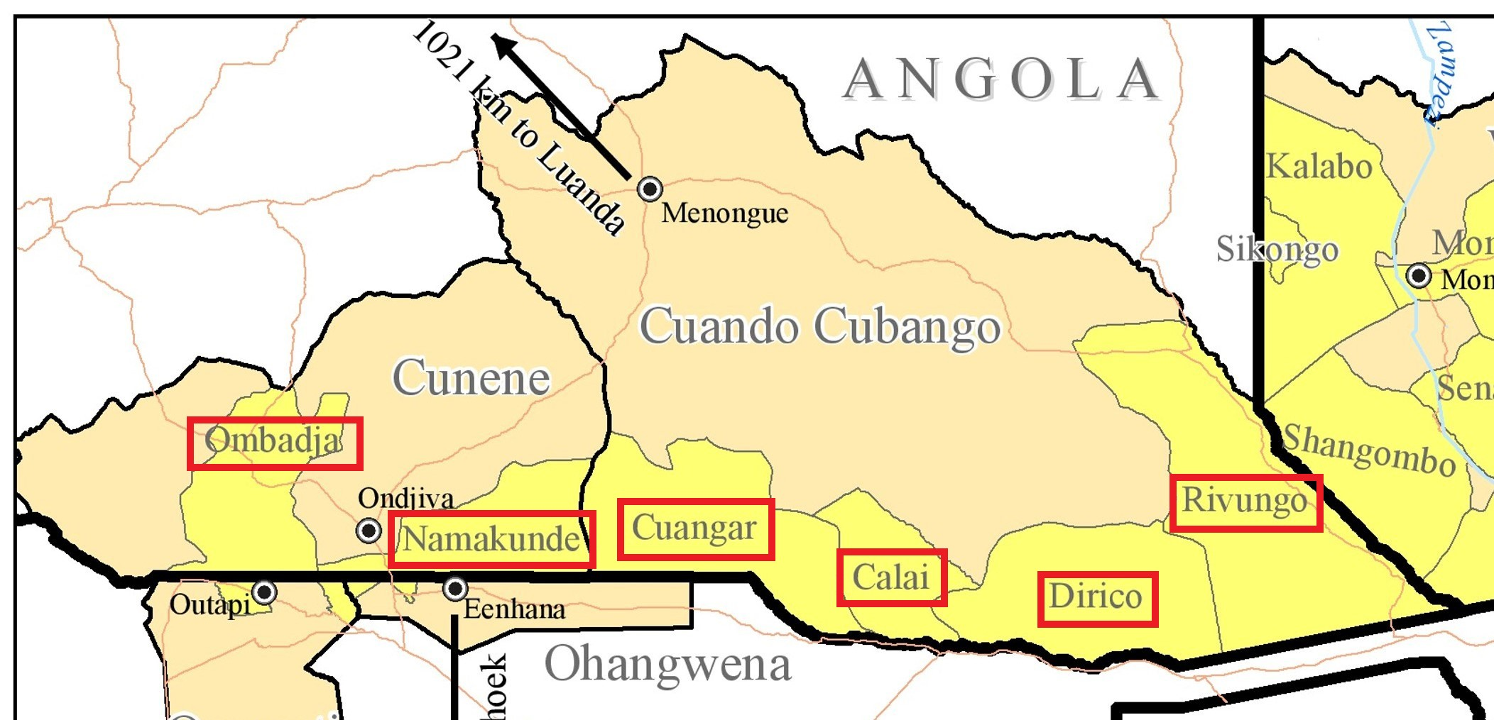
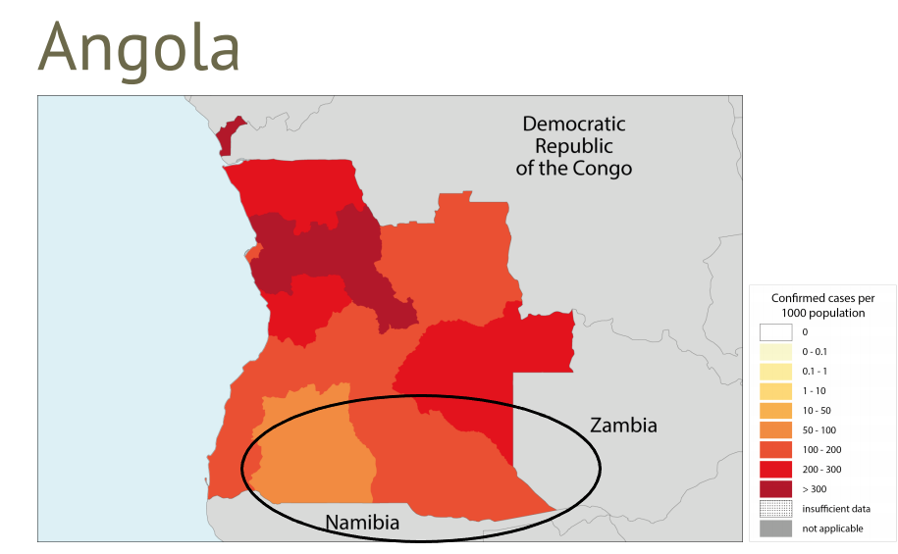
Identifying behavioral drivers of transmission in southern Angola’s Isdell:Flowers Cross Border Malaria Initiative program area communities
João Lino Rafael & Alysse Maglior
Thematic area: Regional and Cross Border Malaria
Background
Results:
The Anglican Diocese of Angola, through the Trans Kunene Malaria Initiative (TKMI), facilitates the Isdell:Flowers Cross Border Malaria Initiative (IFCBMI) in Angola. IFCBMI works in partnership with Angola’s National Malaria Control Program to accelerate malaria elimination through community engagement, malaria education, and community-based malaria case management in remote communities within 2 municipalities in Cunene Province and 4 municipalities in Cuando Cubango Province (Fig 1). These municipalities are of regional relevance because they border Namibia, a country approaching elimination, and pose a threat due to their relatively higher malaria burden (Fig 2). The current understanding of the local factors contributing to malaria transmission along Angola’s southern border is insufficient.
Figure 1. Isdell:Flowers Cross Border Malaria Initiative program areas
Knowledge: Knowledge of disease severity (can be deadly if left untreated) was high. The majority of participants identified mosquitoes as cause of malaria (and nothing else incorrect) and identified fever/chills as a symptom of malaria. Knowledge of low-density (asymptomatic infections) was low in Cunene.
Insecticide treated nets (ITNs): Access (defined as 1 ITN for every 2 people who slept in the household the previous night) is a main driver of ITN use. Use of ITNs the previous night was low overall. However, given access, use of ITNs is high.
Figure 2. Malaria incidence rate in Angola
Care-seeking behavior: Prompt (within 24 hours of fever onset) care-seeking at a health facility or community health worker (CHW) was the largest barrier to proper malaria care (403/663). Almost all (265/269) children that tested positive received malaria treatment, and most (227/265) took the full medication course.
Aim:
In order to take action toward reducing malaria cases in Angola and ensuring Namibia reaches elimination, we sought to understand the current reality of malaria-related knowledge, care-seeking behavior for febrile children under age 5, and access to, use of, and attitudes toward malaria preventive practices among community members living in Isdell:Flowers Cross Border Malaria Initiative program areas in southern Angola.
Methodology:
Format:
Cross-sectional household survey
Structured questionnaire administered on tablets through the KoboCollect platform
Sample size and sampling:
Sample sizes calculated to achieve 80% power to detect annual incremental improvements in key outcome measures in future years
Representative of IFCBMI program areas
Household selection conducted by systematic random sampling
Survey participants:
Female mothers/caregivers of children <5 years. A non-mother/caregiver female was interviewed if there were no children in the household or if a mother/caregiver wasn’t available.
18 years old or older
Provided informed consent
Conclusions:
Malaria knowledge among community members in Cunene and Cuando Cubango is relatively high overall but could benefit from increased education on identifying the cause of malaria in Cunene and identifying fever as a symptoms of malaria in both areas. As Angola approaches elimination, communities in Cunene and Cuando Cubango will need robust education on low-density asymptomatic infections. Use of ITNs in Angola, especially Cunene, could be improved to reduce exposure to mosquitos and decreases cases. However, low usage doesn’t appear to be driven by behavior, but rather access to nets in good condition. Therefore, more nets are needed in these areas. Action is needed to increase the behavior of seeking care from a health facility or CHW promptly (within 24 hours of fever onset), as this appears to be the biggest barrier to ensuring all cases of malaria in children <5 are detected and treated in Cunene and Cuando Cubango.
João Lino Rafael, Project Manager, Trans Kunene Malaria Initiative & J.C. Flowers Foundation | +244 923 476 766 | Jolira50@gmail.com

